Slide 1

Reflexion: Language Agents with Verbal Reinforcement Learning
Tanzir Hossain 20301154
Notes:
1. Table of contents
2. Introduction
3. Quote
4. Study objectives
5. Literature review
6. Schedule
7. Methodology
8. Table
9. Results analysis
10. Conclusions
11. Bibliographical references

Slide 2
Introduction
Large language models (LLMs) increasingly used as goal-driven agents interacting with environments
Traditional RL requires extensive training samples and expensive model fine-tuning
Propose Reflexion, a framework where agents learn via linguistic self-reflection instead of weight updates
Agent verbally reflects on feedback, maintains text in episodic memory to induce better decisions
More flexible than scalar rewards for nuanced feedback and transparent memory
Tested on decision-making (AlfWorld), reasoning (HotPotQA), programming (HumanEval) tasks
Reflexion improved over baselines by 22% (AlfWorld), 20% (HotPotQA), 11% (HumanEval)
Self-reflection more effective than rewards or memory alone for identifying mistakes
Emergent capability of LLMs to learn via trial, error and deliberate self-reflection
Reflexion is a promising avenue for sample-efficient and interpretable reinforcement learning

Slide 3
Motivation
Large language models (LLMs) increasingly used to interact with environments as goal-driven agents
Traditional RL requires extensive training samples and expensive model fine-tuning
Need more sample efficient ways for language agents to learn from trial-and-error

Slide 4
Methodology
Reflexion uses Actor, Evaluator, Self-Reflection models
Actor generates actions, Evaluator provides rewards
Self-Reflection converts rewards to verbal feedback as memory
Memory provides useful context to improve on next trial

Slide 5
Analysis
Self-reflection identifies mistakes, suggests better actions
More effective than reward gradients or episodic memory alone
Flexible - works with different tasks, feedback types, models

Slide 6
Limitations
Relies on quality of self-evaluation and memory encoding
No guarantee of optimality, can get stuck in local minima
Memory capacity limited due to LLM constraints

Slide 7
Related Works
Self-Refine: Iterative single-step generation refinement
Beam Search: Foresight via stochastic search
CodeT: Uses self-generated unit tests

Slide 8
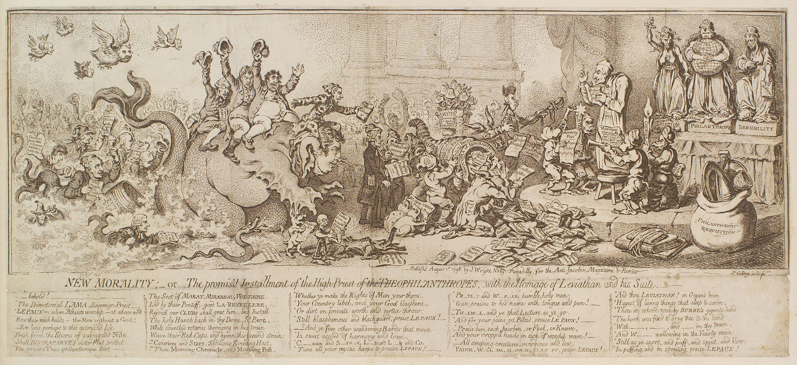

Thanks
Presentation done by
Tanzir Hossain
Fin
Please keep this slide for attribution

